Slide 1
Silly Stories

Slide 2
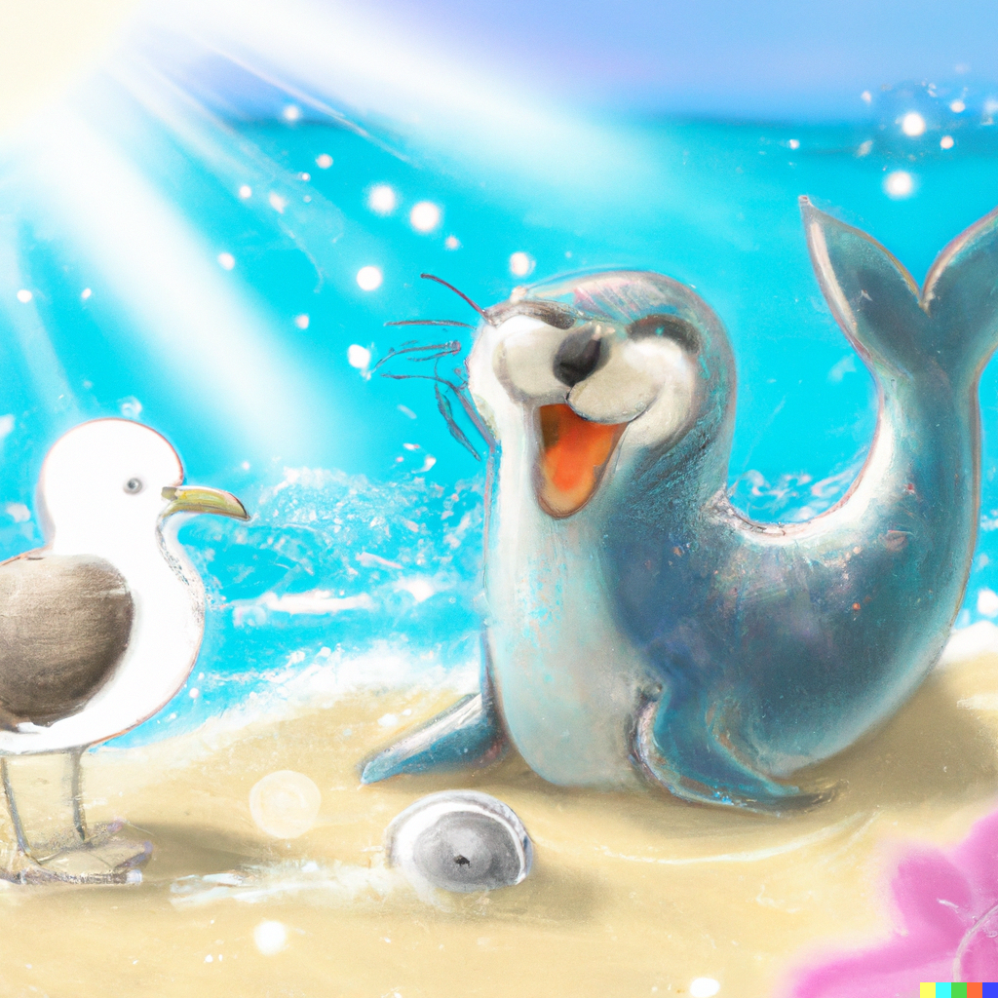
Sammy the Silly Seal
Sammy, the silly seal, swam in the sparkling sea.
He played with Sally Seagull, with shells and so much glee.
Swishing by the shore, they searched for shiny shells,
Sammy and Sally smiled, as their collection swelled.
Together, they sang sweet songs, spreading joy around.
Sammy, the silliest seal, was a friend they'd always found.

Slide 3
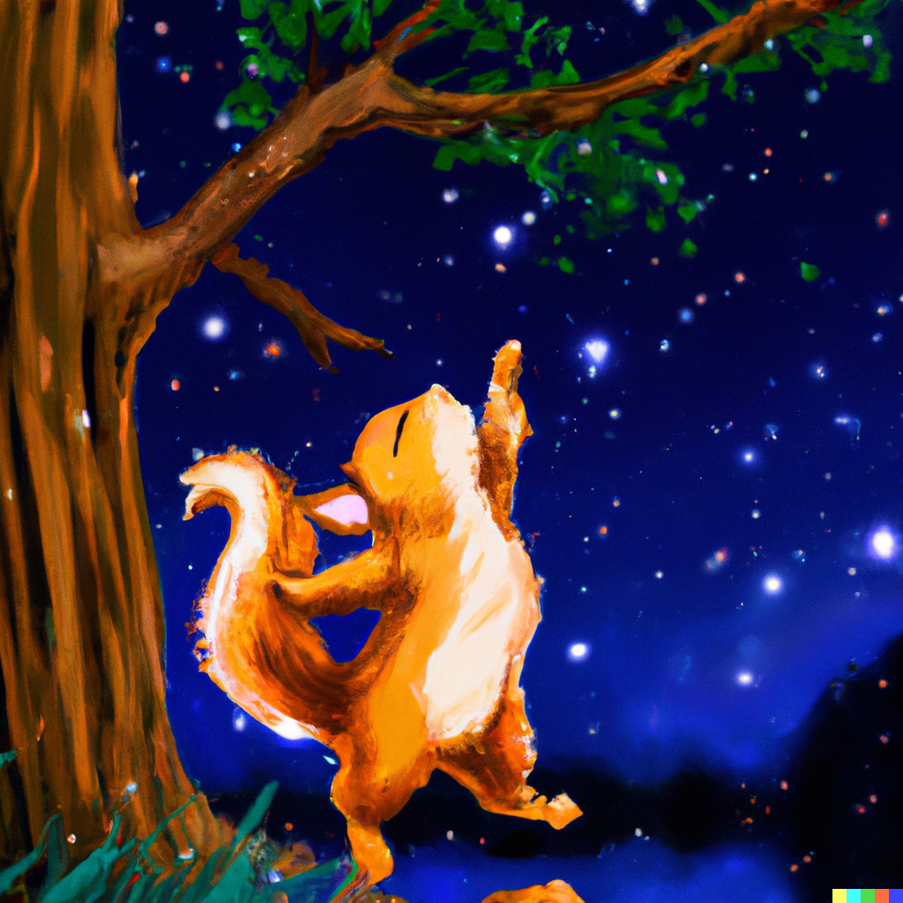
Sasha's Starry Sky
Sasha, the small squirrel, loved strolling near the stream.
Each night, she'd scamper 'neath the stars that brightly gleamed.
She danced on swaying branches, under silver, starry light,
Gazing at the sky above, a dazzling, sparkling sight.
As Sasha scurried, she'd softly hum a song of sweet delight,
For every single shining star lit up her world each night.

Slide 4
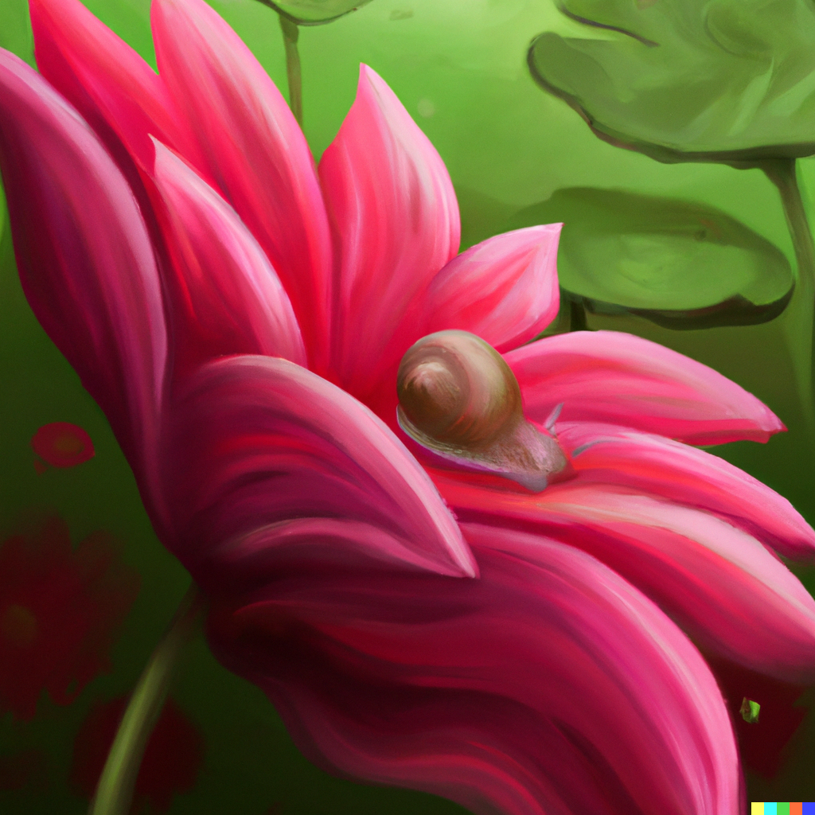
Sophie's Sweet Surprise
Sophie, the shy snail, slid slowly through the garden,
Admiring special blossoms, seeking one to pardon.
A splendid, scarlet flower caught her tiny eyes,
She slid up its stem, a sweet surprise to find.
Safe inside the petals, she savored the scent so rare,
Sophie, the shy snail, found her secret garden lair.

Slide 5
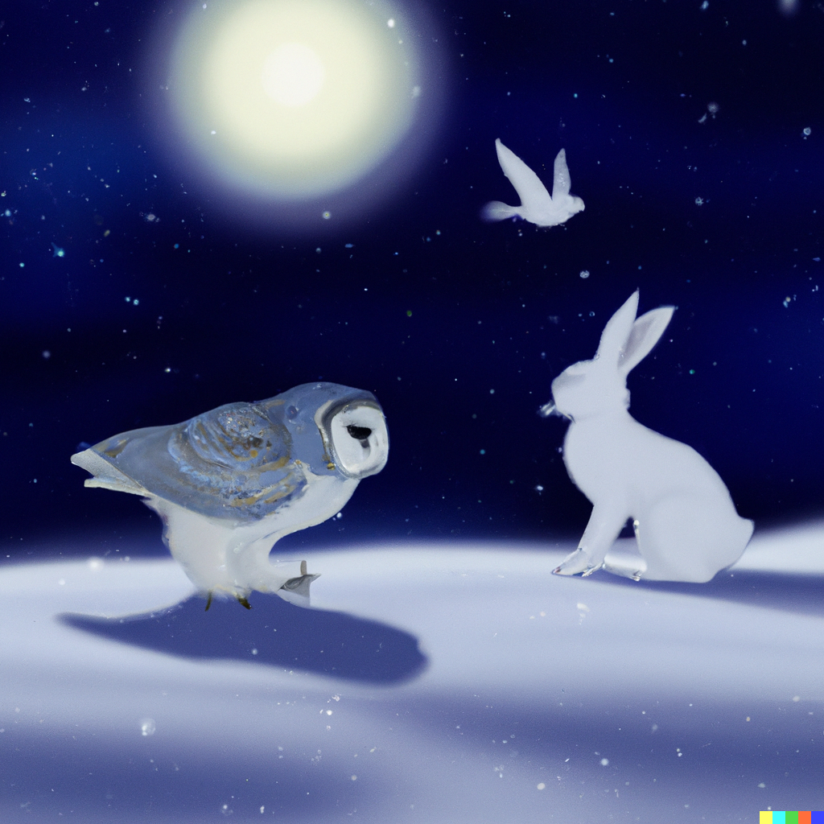
Simon's Snowy Stroll
Simon, the spotted snowshoe hare, hopped softly in the snow,
Through frosty fields and silent woods, under moon's subtle glow.
He met a snowy owl who swooped, a swirling sight to see,
Together they shared sprints and swoops, in snowy harmony.
In this wintry wonderland, they played till stars shone bright,
Simon's snowy, spirited night was a pure, snowy delight.

